Slide 1

The Simplest Classification: Naive Bayes
Uday Keith

Slide 2
Probabilistic Modelling
For classification problems, we are often dependent on probabilistic models. That is models that calculate the probability of something belonging to a class.
We have already encountered a probabilistic model, Logistic Regression.
Logistic regression involves directly modeling Pr(Y = k|X = x) using the logistic function,for the case of two response classes. In statistical jargon, we model the conditional distribution of the response Y , given the predictor(s).
Today we will consider another probabilistic approach to calculate the same probability Pr(Y = k|X = x), Naive Bayes.

Slide 3
Probabilistic Modelling
Suppose that we wish to classify an observation into one of K classes, where K ≥ 2.
The probability that a given observation is associated with the kth category of the response variable Y is called the prior probability.
Estimating the prior is easy if we have a random sample of Y’s from the population: we simply compute the fraction of the training observations that belong to the kth class.
We refer to p_{k}(x) as the posterior probability that an observation belongs to the kth class. That is, it is the probability that the observation belongs to the kth class, given the predictor value for that observation.
Lets look at a concrete example next.

Slide 4
Probabilistic Modelling
We want to understand which employee in a company has written a certain email. This email has three salient words: “Important”, “Successful” and “Salute”. We have two possible suspects, A and B.
Look at their historical emails, we find that A has “Important” in 10% of his emails, “Successful” in 80% and “Salute”, 10%. B has “Important” in 50% of his emails, “Successful” in 20% and “Salute”, 30%.
So currently, our prior probability of who wrote the email of we have K = 2 is P(A) = P(B) = 0.5
What about the posterior probability of who wrote the email given each of those words? What is P(A|X=[”Salute|Important”])? What is P(B|X=[”Salute|Important”])?To calculate this, we use Baye’s theorem.
Notes:
Probability of A writing an email with the word “Salute” AND the word “Important”?
= Pr(A|X=”Salute”) * P(A|X=”Important”)
= Pr(X=”Salute”|A) * P(A) * Pr(X=”Important”|A) * P(A)
= 0.1 * 0.5 * 0.1 *0.5

Slide 5
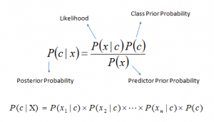
Probabilistic Modelling
Bayes Theorem
Here, P(c) is our prior and P(c|x) is our posterior. So, lets calculate, P(A|X=[”Salute|Important”]). So P(A) = 0.5, P(B) = 0.5 and P(X=”Saute”||A) = 0.1. So, we have numerators = (0.1*0.5) and (.0.1*0.5) What about the denominator?

Slide 6
Probabilistic Modelling
P(x = “Salute”) and P (x = “Important”).
The predictor prior possibility can be understood as the probability of encountering a particular pattern x independent from the class label.
We can formalize this by P(x = “Salute”) = P(Salute|A) * P(A) + P(Salute|B) * P(B).
This is a common term for both our authors.
So, we have P(x = “Salute”) = 0.2 and P (x = “Important”) = 0.3
Dividing our respective denominators by their numerators we have:
P(A|X=[”Salute|Important”]) =
P(B|X=[”Salute|Important”]) =

Slide 7
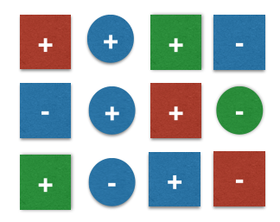

Probabilistic Modelling
Lets take another example, consider the following diagram
The task her is to calculate the prob. Of observing our 13th toy as
Here our class is (-) or (+) the shapes and colors are features.

Slide 8
Probabilistic Modelling
Under the naive assumption that the features “color” and “shape” are mutually independent, the class-conditional probabilities can be calculated as a simple product of the individual conditional probabilities.
Our decision rule is as follows:
Classify sample as + if P(ω=+∣x=[blue, square])≥P(ω=-∣x=[blue, square]) else classify sample as − . So now, calculate each.

Slide 9
Extending our Analysis
There are a few flavours of NB models. These flavors differ on what distribution we assume for P(B|A) or the conditional probability.
That is what distribution we think our features follow. If have data on individuals of only the proportion of common words they use in emails, our data follows a bernoulli distribution. That is a distribution with only two outcomes (author/not-author) and a single feature (one common word) assuming that the occurrence of one word is independent of the next.
If we have text data that is made up of documents (whole sentences, paragraphs etc.) then we care about the potential of co-occurrence of words (multiple keywords in a document). Then we use a multi-nomial NB model.

Slide 10
Extending our Analysis
Finally, if we dont have such discrete of binary variables, and have continuous variables. For a large number of data rows, we would assume a normal distribution and use Gaussian NB.

